Slide 1
Natural Language Processing
Book: Speech and Language Processing, by M. Jurafsky, & J. Martin, New York: Prentice-Hall (2000).

Slide 2
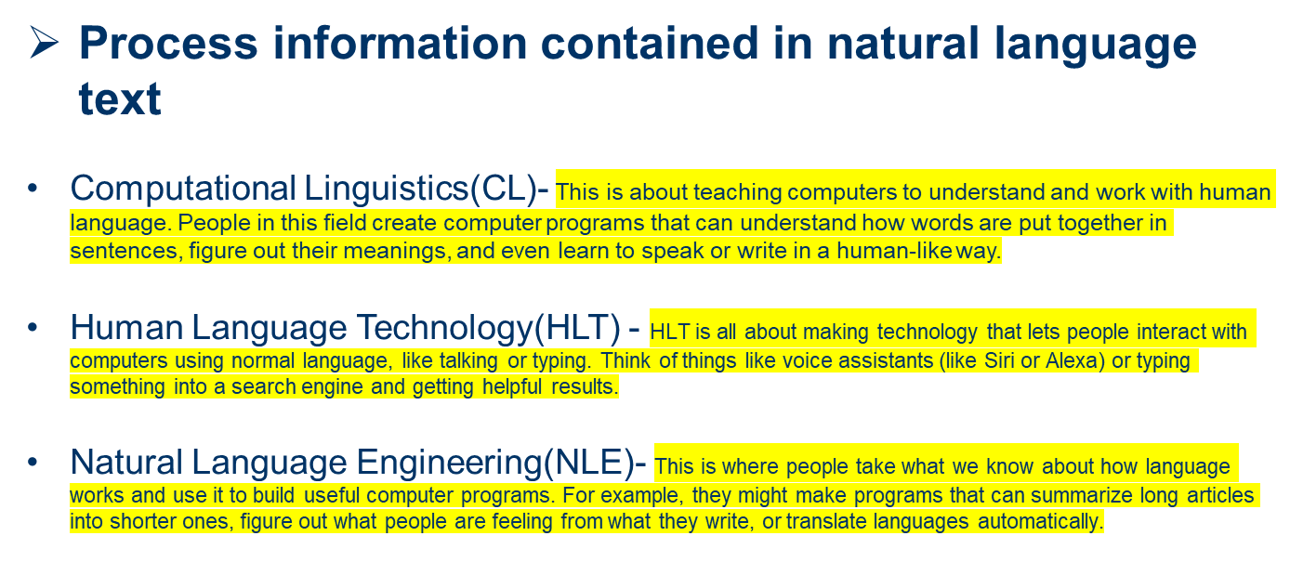
What is natural language processing?

Slide 3
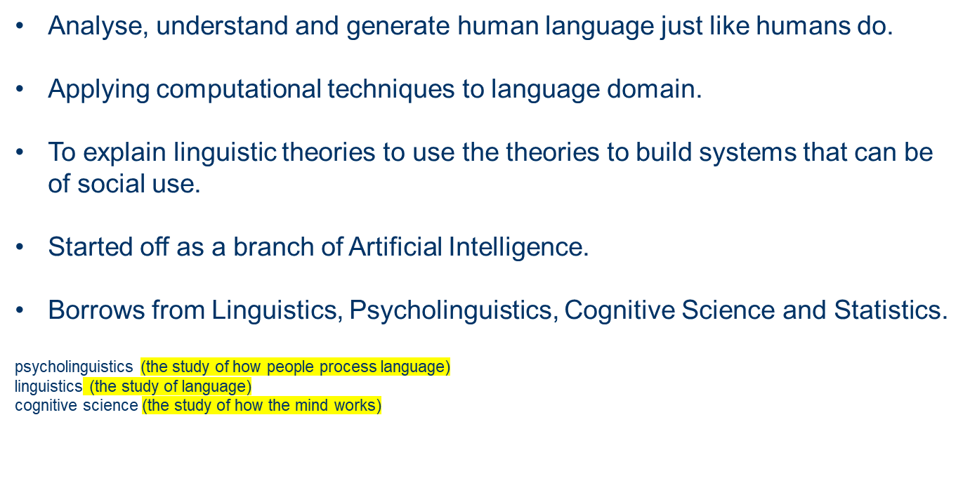
NLP for Machines

Slide 4



NLP Applications

Slide 5
Production-Level Applications
A computer program in Canada accepts daily weather data and
automatically generates weather reports in English and French
Over 1,000,000 translation requests daily are processed by the Babel Fish system available through Altavista
A visitor to Cambridge, MA can ask a computer about places
to eat using only spoken language. The system returns relevant information from a database of facts about the restaurant scene.

Slide 6
Prototype-Level Applications
Computers grade student essays in a manner indistinguishable from human graders
An automated reading tutor intervenes, through speech, when the reader makes a mistake or asks for help
A computer watches a video clip of a soccer game and produces a report about what it has seen
A computer predicts upcoming words and expands abbreviations to help people with disabilities to communicate

Slide 7
Why NLP ?
A hallmark of human intelligence.
Text is the largest repository of human knowledge and is growing quickly
Computer programmes that understood text or speech.

Slide 8
History of NLP
In 1950, Alan Turing published an article titled “Machine and Intelligence” which advertised what is now called the Turing test as a subfield of intelligence.
Some beneficial and successful Natural language system were developed I the 1960s were SHRDLU, a natural language system working in restricted “blocks of words” with restricted vocabularies was written between 1964 to 1966.

Slide 9
Components and Process of NLP
Components of NLP
Linguistics and Language
Steps of NLP
Techniques and Methods

Slide 10
Components of NLP
Natural Language Understanding: taking some spoken/typed sentence and working out what it means.
Natural Language Generation: taking some formal representation of what you want to say and working out a way to express it in a natural(human) language.

Slide 11
Components of NLP
Natural Language Understanding:
Mapping the given input in the natural language into a useful representation.
Different level of analysis required:
Morphological analysis
Syntactic analysis
Semantic analysis
Discourse analysis

Slide 12
Components of NLP
Natural Language Generation:
Producing output in the natural language form some internal representation.
Different level of synthesis required:
Deep planning(what to say)
Syntactic generation
Note: NL Understanding is much harder than NL Generation. But, still both of them are hard.

Slide 13
Linguistics and language
Linguistics is the science of language.
Its study includes:
Sounds which refers to phonology
Word formation refers to morphology
Sentence structures refers to syntax
Meaning refers to semantics
Understanding refers to pragmatics

Slide 14
Steps of NLP
Morphological and Lexical Analysis
Syntactic Analysis
Semantic Analysis
Discourse Integration
Pragmatic Analysis

Slide 15
Morphological and Lexical Analysis
The lexicon of a language is its vocabulary that includes its words and expressions.
Morphology depicts analysing, identifying and description of structure of words.
Lexical analysis involves dividing a text paragraphs, words and the sentences.

Slide 16
Syntactic Analysis
Syntax concerns the proper ordering of words and its affects on meaning
This involves analysis of the word in a sentence to depict the grammatical structure of the sentence.
The words are transformed into structure that shows how the words are related to each other
For example: “the girl the go to the school”. This would definitely be rejected by the English syntactic analyser.

Slide 17
Semantic Analysis
Semantics concerns the (literal) meaning of word, phrases and sentences.
This abstracts the dictionary meaning or the exact, meaning from the context.
The structures which are created by the syntactic analyser are assigned meaning.
For example: “colourless blue idea”. This would be rejected by the analyser as colourless blue do not make any sense to gether.

Slide 18
Discourse Integration
Sense of the context
The meaning of any single sentence depends upon the sentences that precedes it and also invokes the meaning of the sentences that follow it.
For example: the word “it” in the sentence “she wanted it” depend upon the prior discourse context.

Slide 19
Pragmatic Analysis
Pragmatics concerns the overall communicative and social context and its effect on interpretation.
It means abstracting or deriving the purposeful use of the language in situations.
Importantly those aspects of language which required world knowledge.
The main focus is on what was said is reinterpreted on what it actually means.
For example: “close the window?” should have been interpreted as a request rather than an order.

Slide 20
Natural Language Generation
NLG is the process of constructing natural language outputs from non-linguistic inputs
NLG can be viewed as the reverse process of NL understanding
A NLG system may have following main parts:
i) Discourse Planner: what will generated, which sentences
ii) Surface Realizer: realises a sentence from its internal representation
iii) Lexical Selection: selecting the correct words describing the concepts

Slide 21
Techniques and methods
Machine Learning
The learning procedures used during machine learning
Automatically focuses on the most common cases
Whereas when we write rules by hand it is often not correct at all
Concerned on human errors

Slide 22
Techniques and methods
Statistical inference
Automatic learning procedures can make use of statistical inference algorithms
Used to produce models that are robust(means strength) to unfamiliar input e.g. containing words or structures that have not been seen before
Making intelligent guesses.

Slide 23
Techniques and methods
Input database and Training data
System based on Automatically learning rules can be made more accurate simply by supplying more input data or source to it.
However, system based on hand-written rule can only be made more accurate by increasing the complexity of the rules, which is a much more difficult task.

Slide 24
Natural language vs. Computer language
Ambiguity is the primary difference between natural and computer language.
Formal programming language are designed to be unambiguous. They can be defined by a grammar that produces a unique parse for each sentence in the language.
Programming languages are also designed for efficient(deterministic) parsing.
They are deterministic context-free languages(DCLFs)

Slide 25
Future of NLP
Make computers as they can solve problems like humans and think like humans as well as perform activities that humans cannot perform and making it more effiecient than humans.
As natural language understanding or readability improves, computers or machines or devices will be able to learn from the information online and apply what they learned in the real world.

Slide 26
Difficulties in NLP
“The person who done it- it’s their fault”
“The man who knew him went left”
“The man who knew he went left”
Mother was baking.
The apple pie was baking.
Mother baked an apple pie.
An apple pie was baked by mother.

Slide 27
Lexical ambiguity
“Time flies like an arrow.”
“I saw that gas can explode.”
“They should have scheduled meeting.”
“Visiting relatives can be annoying.”
Note: ambiguity due to class of word.

Slide 28
Lexical ambiguity
“The pitcher fell and broke”
“The water is in the pitcher.”
“John drank a pitcher.”
“John drank a tall pitcher while watching the baseball game.”
“She approached the bank.”
Note: ambiguity due to multiple definitions.

Slide 29
Syntactic ambiguity
“John saw the woman in the park with a telescope.”

Slide 30
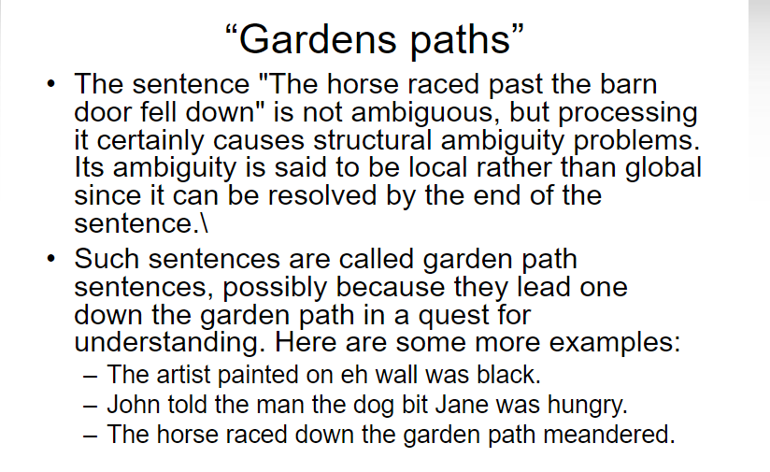

Slide 31
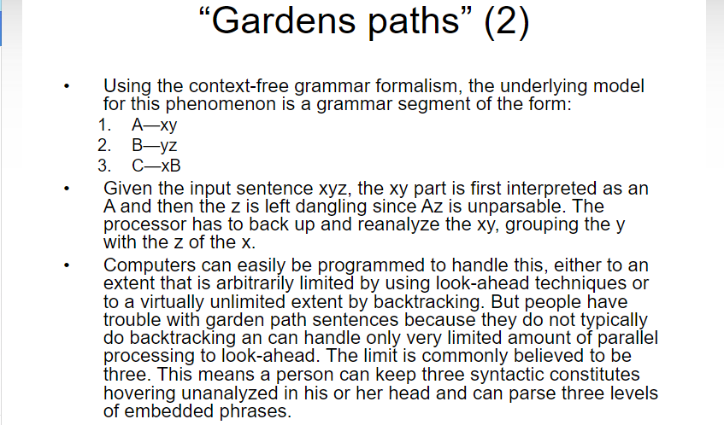

Slide 32
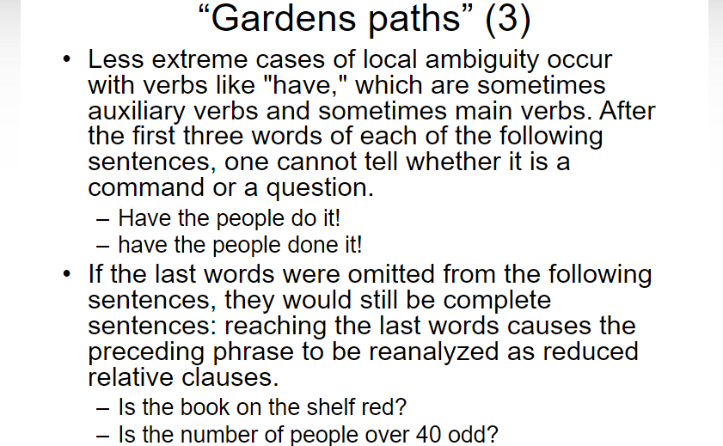

Slide 33
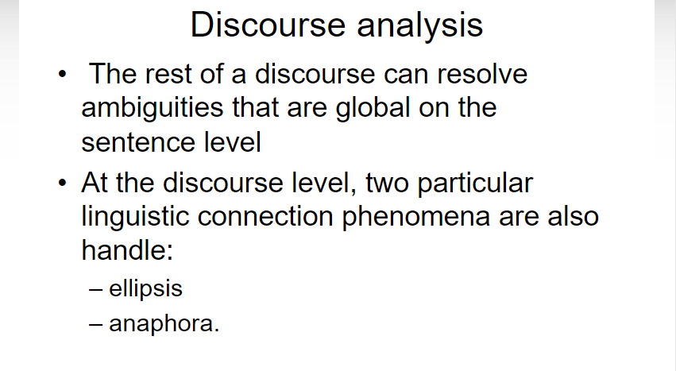

Slide 34
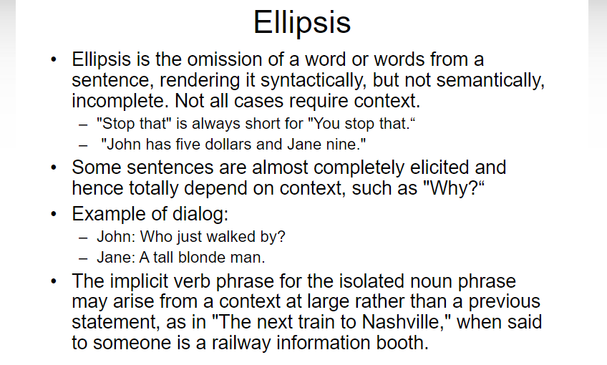

Slide 35
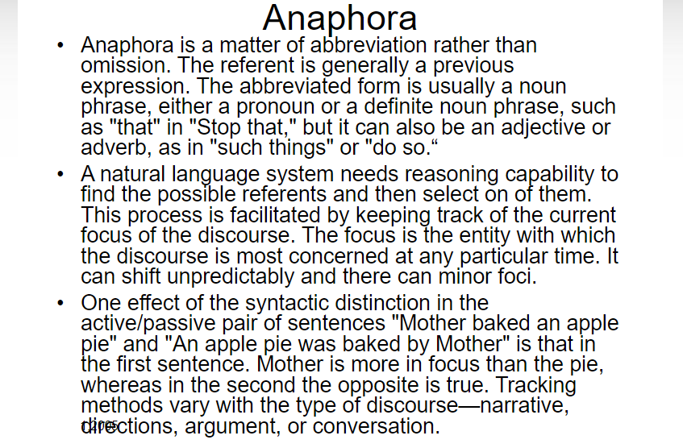

Slide 36
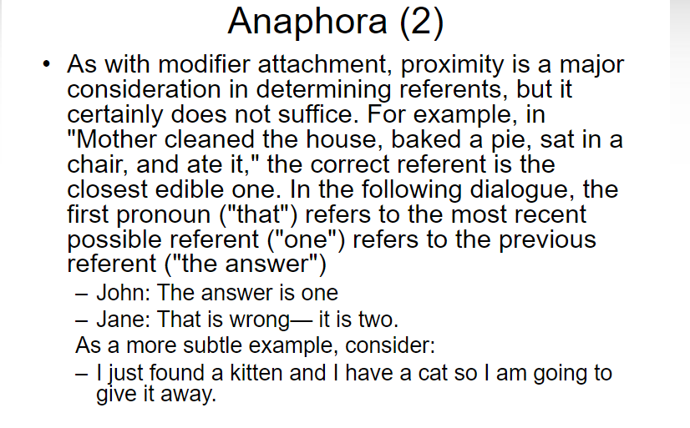

Slide 37
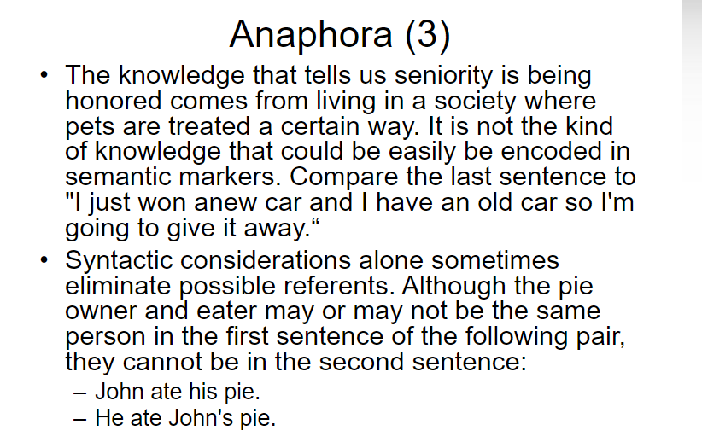

Slide 38
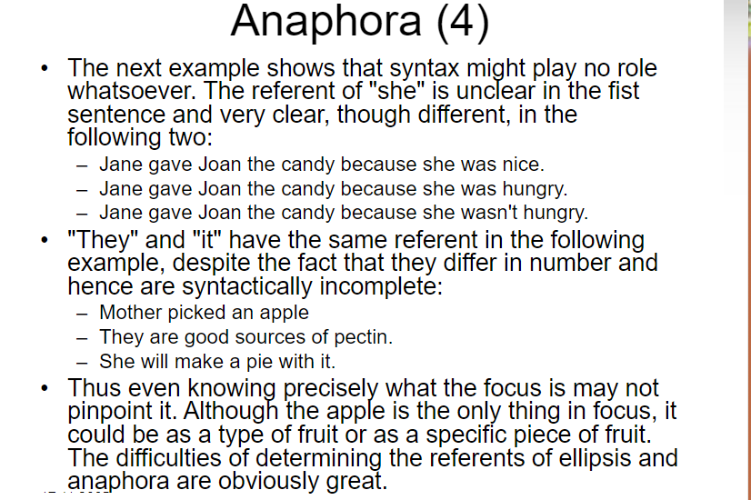

Slide 39
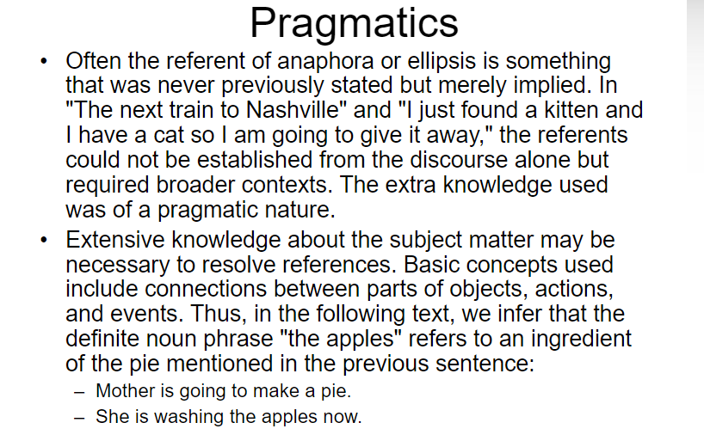

Slide 40
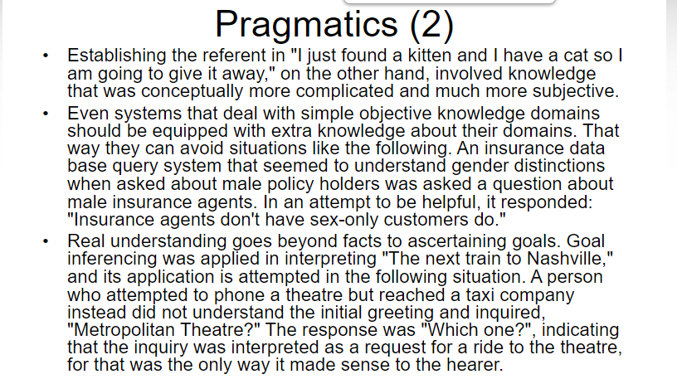

Slide 41
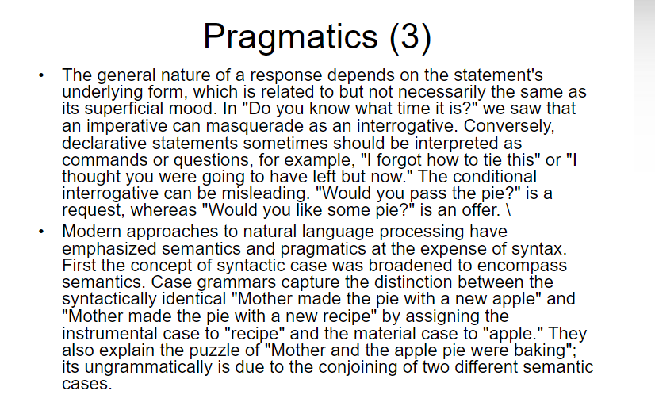

Slide 42
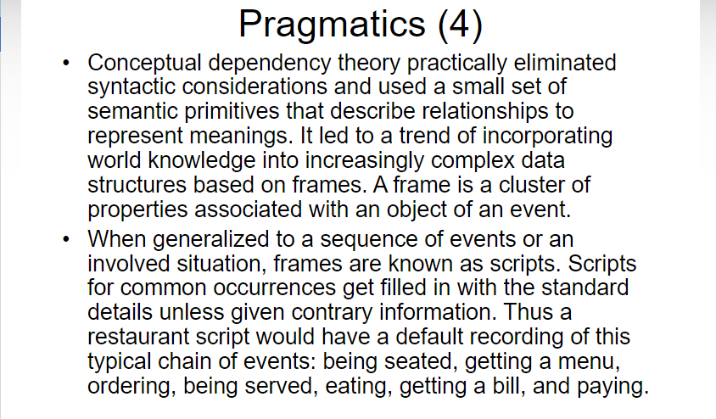

Slide 43
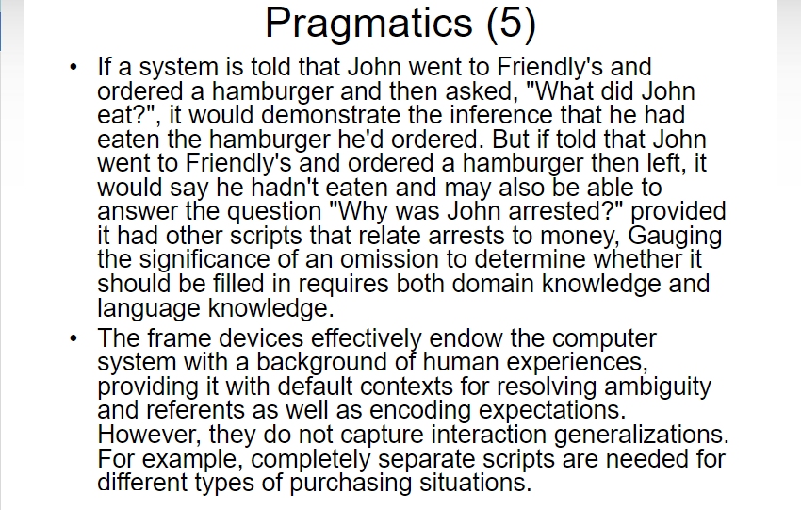

Slide 44
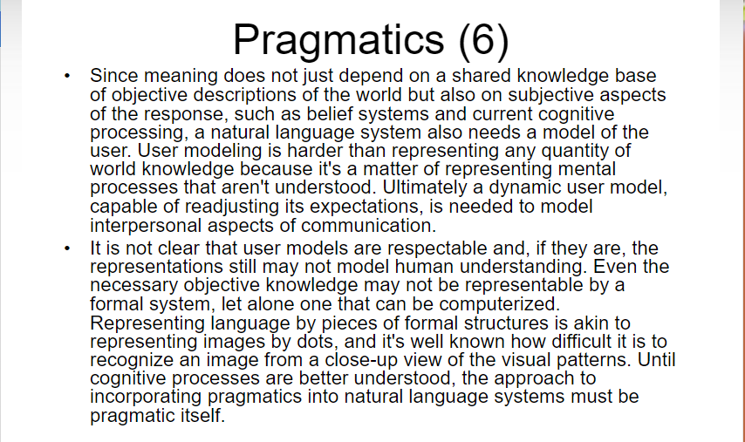

Slide 45
